Slide 1
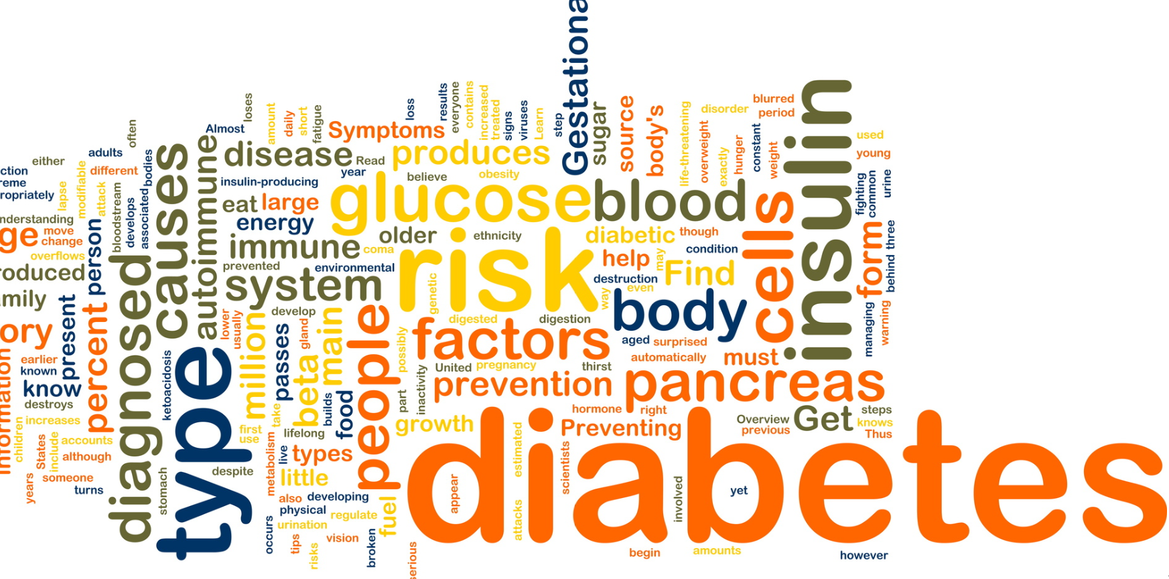
Survival analysis of diabetes

Slide 2
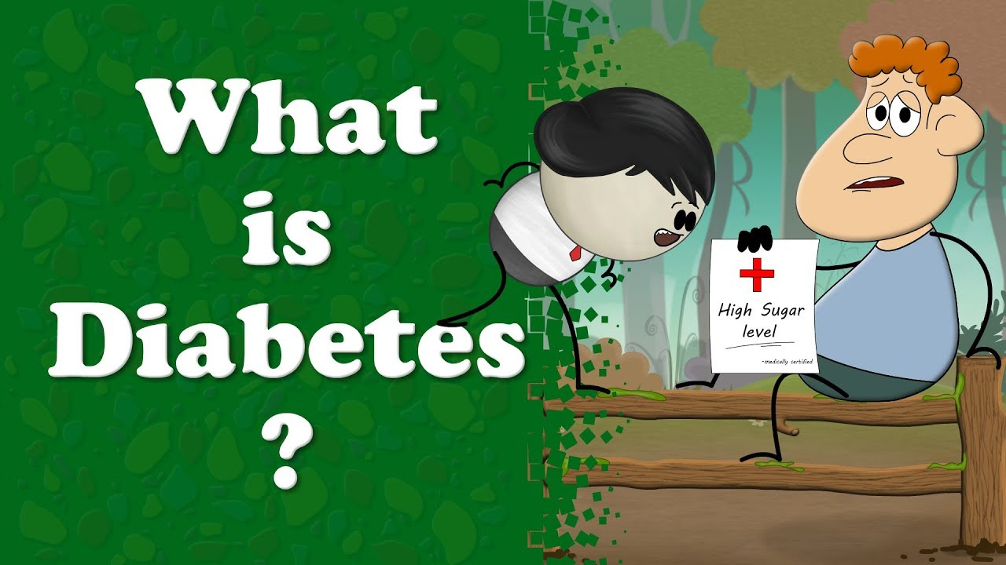

Slide 3
Diabetes:
Diabetes is a condition that happens when the blood glucose levels are too high.
Our body cells need glucose as our source of energy and the process of maintaining a balance of glucose in cells and in blood, is taken care of by a hormone called insulin, released by the pancreas.
Types of diabetes
Type 1 occurs when the body does not produce enough of the hormone that allows cells to absorb and use glucose. This hormone is called insulin.
A person with type 1 diabetes will need to take insulin for the rest of their life.
Type 1 diabetes can occur at any age, although it is more common in children and young adults.
Diabetes is a problem with your body that causes blood glucose (sugar) levels to rise higher than normal. Type 2 diabetes is the most common form of diabetes.
This is when the insulin produced is not enough for function, or when the insulin is not able to function properly, often due to insulin resistance.

Slide 4
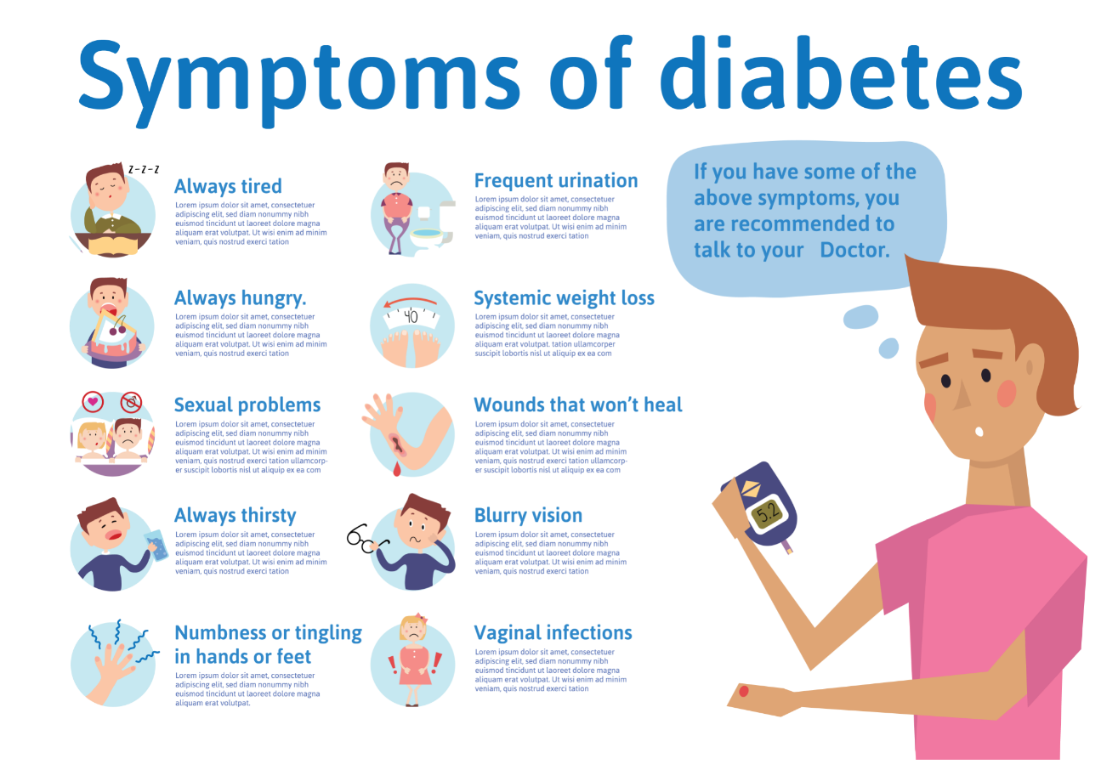
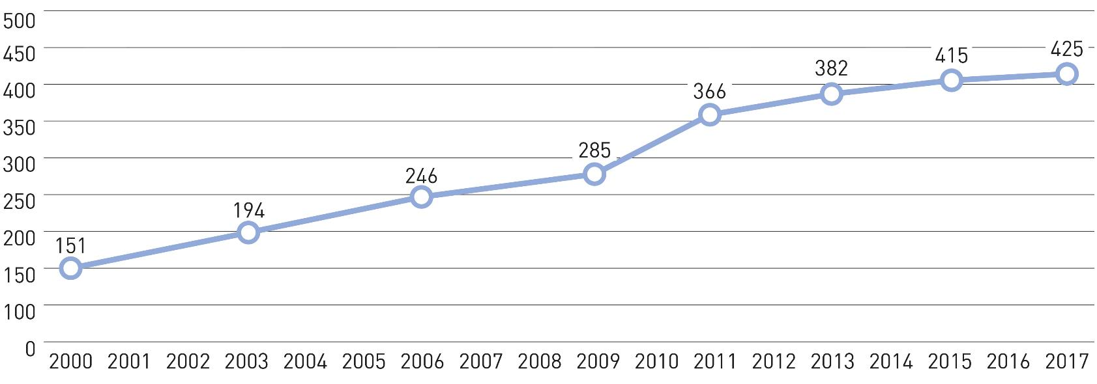
Pre-diabetes
Above average blood glucose levels, not high enough to be classified under type1or type2 diabetes.
Symptoms of diabetes:
High blood levels of glucose
Fatigue
Painful urination
Vomiting
Weight loss
Hunger and thirst

Slide 5
For prediction of diabetes using ML algorithms:
9 features in the dataset:
pregnancies
Glucose
BloodPressure
SkinThickness
Insulin
BMI
DiabetesPedigreeFunction
Age
Outcome
We need to acquire all the data and make a model using multiple algorithms so that we can compare and identify the best algorithm for use.
Here we are using the classification model
The algorithms we use and compare for this dataset are:
Decision tree
Logistic regression
K Nearest Neighbor
Random forest

Slide 6
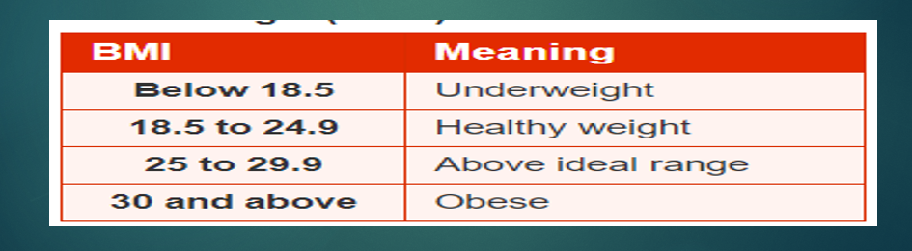
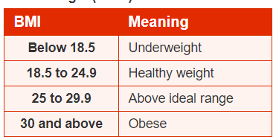
Pregnancy:
Below 7.8 mmol/L, the test is normal.
Above 11.0 mmol/L, it is gestational diabetes.
Glucose: A fasting blood sugar level from 100 to 125 mg/dL is considered pre-diabetes.
Blood pressure:
Type 1 diabetes: Below 135/85 mmH
TypTe 2 diabetes: Below 140/80 mmHg
The NHS regards an ideal blood reading as being below 120/80mmH
Skin thickness:
It is primarily determined by collagen content and is increased in insulin-dependent diabetes mellitus (IDDM).
Insulin:
It is an anabolic hormone that promotes glucose uptake, glycogenesis, lipogenesis, and protein synthesis of skeletal muscle.
BMI:

Slide 7
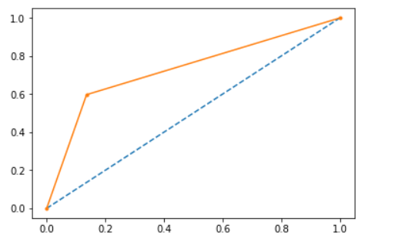
dimensions of data:(768,9)
“Outcome” is the feature we are going to predict:
0 means No diabetes
1 means diabetes
Of these 768 data points:
500 are labeled as 0
268 are labeled as 1
x
ROC Curves and AUC in Python:
The function takes both the true outcomes (0,1) from the test set and the predicted probabilities for the 1 class. The function returns the false positive rates and true positive rates for each threshold.

Slide 8
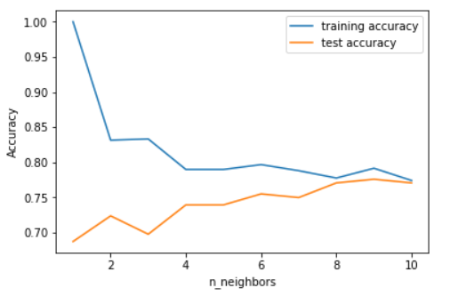

k-nearest neighbor
KNN is one of the simplest algorithms used in Machine Learning for regression and classification problem.
KNN algorithms use a data and classify new data points based on a similarity measures. Classification is done by a majority vote to its neighbors.
The data is assigned to the class which has the most nearest neighbors. As you increase the number of nearest neighbors, the value of k, accuracy might increase.
To determine which of the K instances in the training dataset are most similar to a new input a distance measure is used. For real-valued input variables, the most popular distance measure is Euclidean distance.

Slide 9
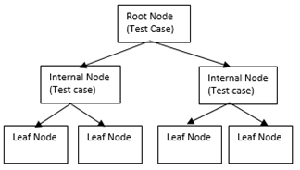
Decision tree
Decision-Tree is a tree structure which has the form of a flowchart.
It can be used as a method for classification and prediction with a representation using nodes and internodes. Root and internal nodes are the test cases. Leaf nodes are considered as class variables.
In order to classify a new item, it creates a decision tree based on the attribute values of the available training data set. Every node of the tree is generated by calculating the highest information gain for all attributes.
If any attribute gives an unambiguous end result, the branch of that attribute will be terminated and then the target value is assigned to it. The following diagram shows a sample decision tree.

Slide 10
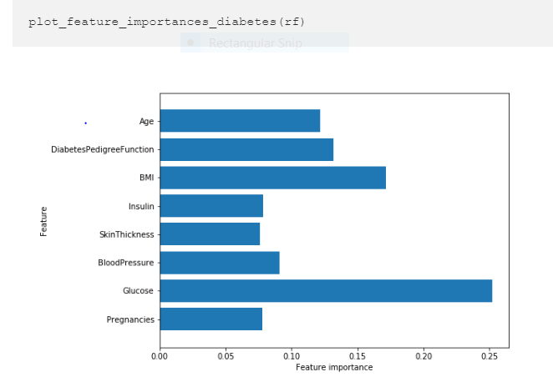
Random Forest
RF is a classification by using many decision trees. It is a multifunctional machine learning method.It can perform the tasks of prediction and regression.
RF generates many decision trees, which is very different from decision tree algorithm.
When the RF is predicting a new object based on some attributes, each tree in RF will give its own classification result and ‘vote,’ and then the overall output of the forest will be the largest number of taxonomy.

Slide 11
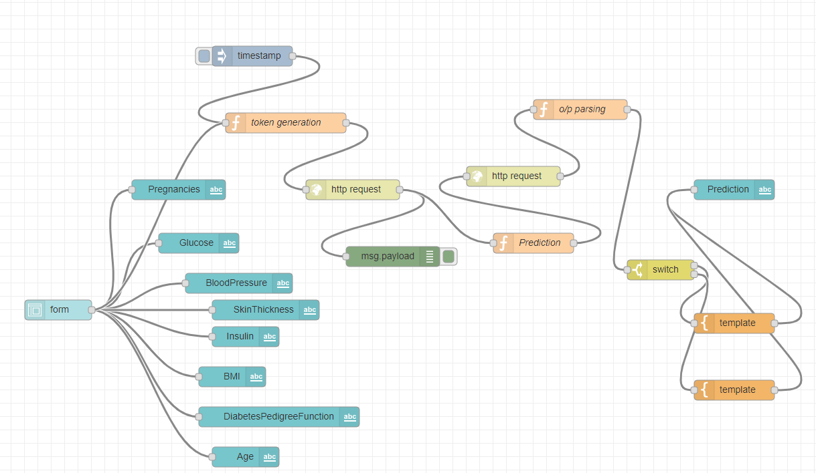
Node red flow: Node-RED contains a set of nodes which offer machine learning functionalities. These flows create a dataset, train a model and then evaluate it. Models, after training, can be use in real scenarios to make predictions. Flows and test datasets are available in the 'test' folder. Make sure that the paths specified inside nodes' configurations are correct before trying to execute the program. Tip: you can run 'node-red' (or 'sudo node-red' if you are uning linux) from the folder '.node-red/node-modules/node-red-contrib-machine-learning' and the paths will be automatically correct.

Slide 12
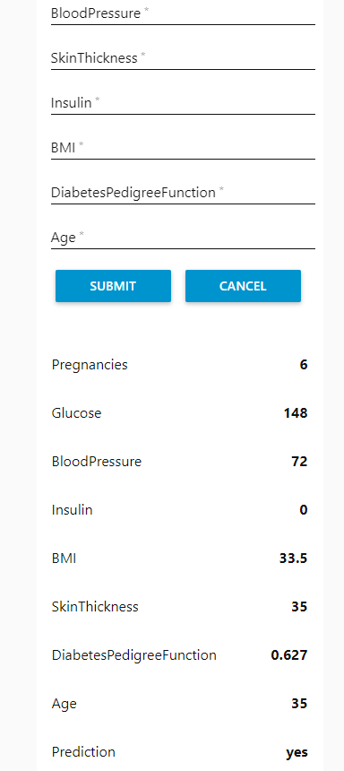

Slide 13
Conclusion:
You have seen that even if someone feels they are in good health, they may still have risk factors that could increase the chances of getting diabetes-related complications. It is important to create a plan, which is agreed between the person with diabetes and the health professional, to show what actions need to be taken to reduce risk factors or maintain low risk.
We can say “No” to diabetes by proper awareness, routine healthcare check-ups, healthy lifestyles and avoiding metabolic syndrome to make a diabetes free world. Studying this course will have built on your knowledge of diabetes and diabetes care systems, and the personal impact of having diabetes, as well as helped you to think about underlying risk factors for complications.

